Slide 2
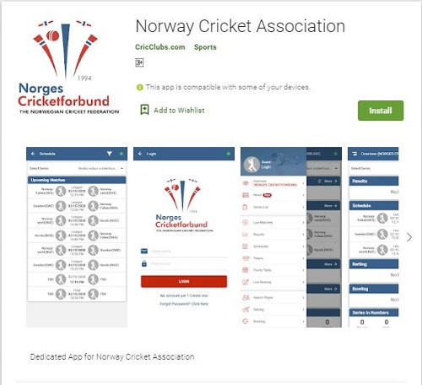
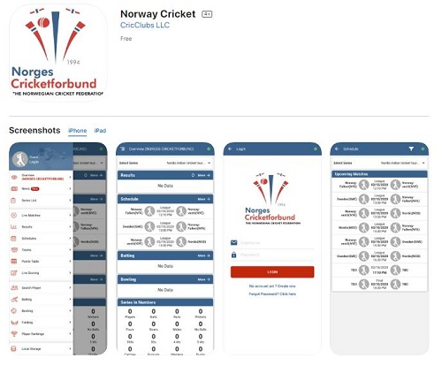
DOWNLOAD
Open Google Play Store.
Search for Norway Cricket Association.
Choose The App and Install.
Open App Store.
Search for Norway Cricket Association.
Choose The App and Install.

Slide 3
Open Norway cricket app and click login from Menu
Enter User Name/Password.
Tap on Login

Slide 17
Off Line Scoring
Scorer can score the match even without connecting to the internet as well.
But we need a internet connection for creating match in the initial stage.
Complete the scoring offline, and connect to the network later upload the unsaved balls from local storage.
(Or) Do scoring off line up to end match and connect to network before Ending the match.
Change Max Overs
Change Max overs from the Actions on the scoring page.
We can change max overs to the batting first team by using the change max overs from actions.
For the batting second team we have to use change target runs, on that screen only we will be able to change the target runs too.
So based on change Max overs/Target runs system will give us the NRR and result automatically

Slide 18
Delayed Match
Delayed match is nothing but the DLS.
We have to choose this option from the actions.
Once we clicked on that delayed match, system will ask us for the input(Number of overs reduced).
Once we enter the input system will give us the revised target and result automatically.
End Match/Over
We can use end match option from the action to end the match at any point of time.
Even for the over also we can use end over option to end the over at any point of time.
Remove Players
By using Remove players option from actions to remove players from Playing XI, if in case we selected unwanted players.

